Slide 1

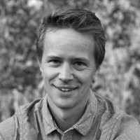
NATE KLEMP
Nate Klemp, PhD, is a writer, philosopher, and entrepreneur. He is the co-author, along with Eric Langshur, of the New York Times Bestseller Start Here: Master the Lifelong Habit of Wellbeing (Simon & Schuster: North Star Way). He is also a founding partner at Mindful, the world's largest mindfulness training and media platform, and was formerly the co-founder and Chief Innovation Officer at LIFE Cross Training (LIFE XT). Along with his wife Kaley, he is the author of the book, The 80/80 Marriage: A New Model for a Happier, Stronger Relationship (Penguin Random House). Prior to creating LIFE XT, Nate worked as an assistant professor of political science and philosophy at Pepperdine University. Nate holds a B.A. and M.A. in philosophy from Stanford University, where he graduated with honors in Ethics in Society, and a PhD in political philosophy from Princeton University.

Slide 2
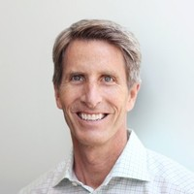
ERIC LANGSHUR
Eric Langshur is the co-founder of Abundant Venture Partners, a purpose based incubator focused on improving the human condition by creating companies that improve; Human Wellness, Human Performance, and Human Engagement. Eric is also co-founder and CEO of AVIA, the nation’s leading health system innovation network seeking to address healthcare’s most pressing challenges by identifying and implementing the best emerging tech-enabled solutions, at scale.
Eric is also a New York Times best selling author. His book, Start Here: Master the Lifelong Habit of Wellbeing, (Simon and Schuster: North Star Way 2016,) synthesizes the world’s ancient wisdom about wellbeing and validates it with cutting edge neuroscience.

Slide 3
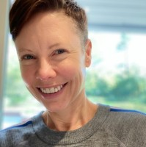
BRENDA JACOBSEN
President of Mindful Communications Brenda Jacobsen has a wealth of healthcare industry experience, and an impressive track record with start-ups and established organizations. Brenda is an accomplished business leader in the health, wellness, and healthcare spaces, with deep expertise in scaling, multi-state business operations, and M&A. The former CEO of Lakeside Medical Centers and Life Cross Training, Brenda’s career has focused on improving the health and wellness of workforces globally, focusing first on physical wellness and now on well-being.

Slide 4
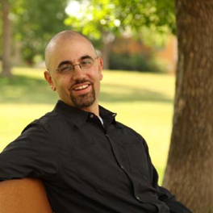
CHRIS PERARO
Christopher Peraro is the Director of Coach Development at LifeXT by Mindful but prefers the underground title of “Ambassador of Soul.” Prior to LifeXT by Mindful, Chris’ career path included counseling and leadership roles in the non-profit sector and in Higher Education supporting the personal and professional growth of undergraduate and graduate students. Chris received his MA in Transpersonal Psychology at Naropa University in Boulder, Colorado, where he fine-tuned his understanding and embodiment of essential practices for facilitating optimal human development. As a coach, Chris enjoys the fine art of tailoring LifeXT by Mindful practices to each person’s individual needs to support sustainable human growth. As a speaker, Chris is fond of cultivating a generous experiential environment whereby groups practice the deep value of LifeXT by Mindful tools and share in the richness of that transformation.

