Slide 1
Notes:
Inovalon is the largest healthcare technology platform that supports Payers, Providers, Pharmacy and Life Sciences
Inovalon’s data set spans:
Largest primary sourced data set in the US
15+ years of Medicare data, including medical and Rx claims
120M active lives
300M+ covered lives

Slide 2
Our history of innovation
Medicare-focused administrative and RCM applications
Care quality management, workforce management, patient pay and expanded data and analytics
Advanced, all-payer applications
Continued innovation for better healthcare workflows
CMS connectivity
2000–2013
2014–2016
2015–2017
2018–today
 | Medicare connectivity Claims and remittance management Eligibility verification Workflow analytics | Clinical outcomes analytics Hospitalization insights Quality assurance benchmarking | Expanded revenue cycle capabilities, including API-based tools and automated systems Workforce management Long-term care risk management Secure on-site and online patient payments by any method, in any setting | Acquired by Inovalon Virtual Care Patient Access Patient Engagement

Slide 3
Solutions Simplify the Complexities of Healthcare
Acute
Post-Acute
Ambulatory
Revenue Cycle Management
ABILITY Patient Engagement
ABILITY Patient Access
Registration & Scheduling
Patient Forms
Virtual Care
Secure Communication
Eligibility Verification
Prior Authorization
Insurance Discovery
Registration Assurance
Patient
Estimation
ABILITY Patient Claims & Billing
Claims Management
DDE/
FISS
Audits & Denials
Patient Statements
Patient Payments
Financial Insights
Care Quality Management
Workforce Management
ABILITY Care Quality
ABILITY Workforce Optimization
Incident/Risk Management
QA Reporting & Analytics
Infection Control & Prevention
Benchmarking
Staff
Scheduling
Credential Tracking
Time & Attendance
Staffing Insights
Cloud Based • Single Platform • Interoperability • EHR Agnostic • Artificial Intelligence • Robotic Process Automation • Analytics
Notes:
Notes –
Quick hitting version:
Cloud based software & analytics simplify admin complexities for Providers. One platform. Trusted advisor. Apps give insights to avoid time consuming tasks to boost efficiency & revenue. ABILITY is part of Inovalon, who focuses on achieving those same results for payers, manufacturers and diagnostics all the way to the patient’s point of care.
WFM – if a department is understaffed or burnt-out, nothing can get done efficiently or safely. That’s where we come in – ABILITY makes sure staff is well-supported and no money goes to waste with our workforce management applications.
Our platform streamlines, automates and gives transparency to the scheduling process, driving better utilization of labor resources while proactively preventing overtime and premium pay spend
Workforce Management
Our Workforce Management suite streamlines, automates and gives transparency to the scheduling process, driving better utilization of labor resources while proactively preventing overtime and premium pay spend with actionable data. It allows for instant communication between staff, eliminating individual phone calls or texts to fill shifts and greatly reducing last-minute open shifts.
Plus, the system tracks licenses and credentials, accounts for scheduled time off and can be configured for custom ratios, staffing rules aduling periods within your organization. Combined, these capabilities increase retention, decrease turnover spending and ensure that shifts are not just staffed, but proactively set up for success.

Slide 4
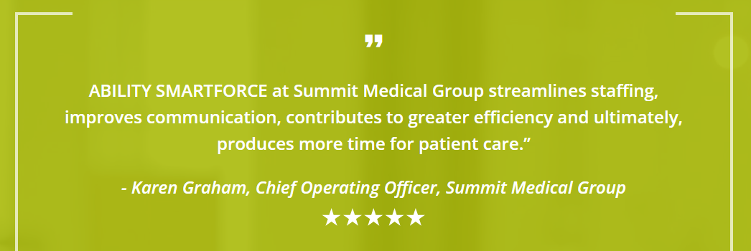
Solutions Simplify the Complexities of Healthcare
Our platform streamlines, automates and gives transparency to the scheduling process, driving better utilization of labor resources while proactively preventing overtime and premium pay spend
Workforce Management
ABILITY Workforce Optimization
Staff
Scheduling
Credential Tracking
Time & Attendance
Staffing Insights
Notes:
If a department is understaffed or burnt-out, nothing can get done efficiently or safely. That’s where we come in – Inovalon makes sure staff is well-supported and no money goes to waste with our workforce management applications.

Slide 5
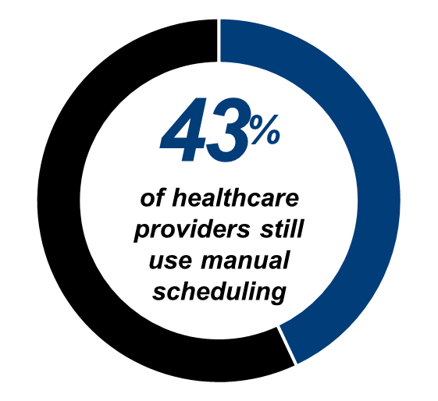
Yesterday’s tools are out of step with meeting today’s challenges.
Why does that matter?
Industry-leading adoption!
Providers are struggling with a labor shortage
It can be challenging to find staff satisfiers
A robust, yet simple app will empower staff to access and control their schedule
Notes:
( use if they are not using automation) Try and imagine doing all you need to do in todays world with a rotary phone or a typewriter. We are now decades into the digital revolution and yet the majority of Senior Care organizations are still using paper or spreadsheets to do staff scheduling. By the end of this short time together, I hope you walk away with a strong understanding of why it no longer makes sense operationally, financially or culturally to put off moving to a technology platform for staff scheduling.
Why does that matter?
Industry-leading adoption!
Providers are struggling with a labor shortage
It can be challenging to find staff satisfiers
A robust, yet simple app will empower staff to access and
control their schedule

Slide 6
The opportunity in modernizing
Decrease turnover
Drive financial performance
Improve operational efficiency
Increase staff satisfaction
Alignment with today’s workforce
Optimize communications
Access and visibility
Manage overtime
Notes:
The work of Senior care is so important and the need for Senior care continues to grow. You should have the best possible tools, to help you in doing that work efficiently and effectively.
To effectively schedule you need reliable, qualified staff. Here are some things to consider around how scheduling automation can help address some of the dissatisfiers that lead to turnover.
Adopt collaborative scheduling practices –This empowers staff members to be active participants in the management of their schedules, which can not only lead to happier employees, it has been shown to improve staffing.
Providing transparency and access – Letting staff know what your needs are gives them the opportunity part of the solution. We have found over and over that when staff can view needs they are more likely to pick up shifts.
Improving staff/manger relationships – This can improve staff manager relationships. It changes the dynamic, where manager aren’t constantly call staff for help and creates an environment of participation.
Supporting recognition – it is often thought that pay is the primary motivator of staff, but that is not the case. Research tells us, and this is magnified with the Millennial generation, that feeling valued, feeling like were making a difference and feeling respected by management are key aspects of job satisfaction and thus retention of talent.
Reputation of a modern organization – If were going to attract
All of this is facilitated by providing staff mobile access to view and manage their schedules, make request, or swap shifts and even integrate their work schedule into their personal schedule.
Adopting a collaborative approach to scheduling can not only facilitate a more engaged workforce, it becomes increasingly important as you adapt to millennials becoming an larger and larger part of our workforce. Taking a more collaborative approach to scheduling can have a big impact on recruitment and retention.

Slide 7
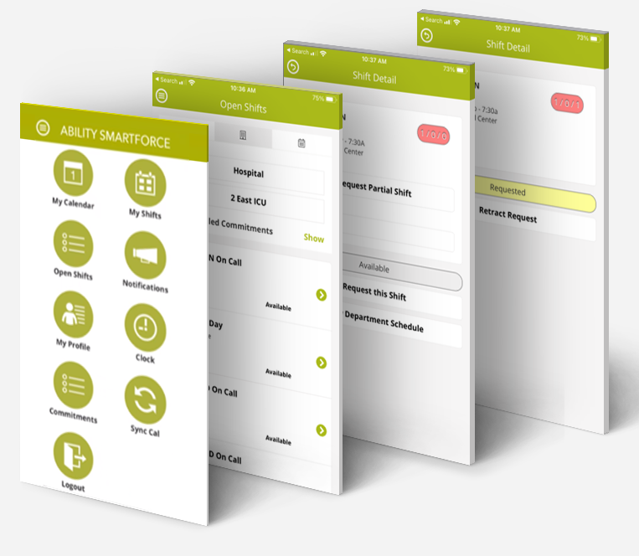
Staffing Insights Assessment
An estimated 35 to 54 percent of the U.S. nursing and physician workforce reports burnout with scheduling being one of the top reasons why nurses are leaving their jobs.
What if Staffing Insights could reduce that number by 1%?
Total # of staff per facility | 9,961
*Healthcare turnover rate | 19.5%
Potential lost resources | 1,942
*Lowest estimate to replace healthcare worker | $28,400
Potential cost of turnover | $55,152,800
What would a 1% reduction in turnover save? | $2,811,600
Notes:
What did Acadia pay for Staffing Insights? $61,200
Healthcare turnover rate - https://www.nsinursingsolutions.com/Documents/Library/NSI_National_Health_Care_Retention_Report.pdf
Lowest estimate to replace healthcare worker - https://www.beckershospitalreview.com/finance/the-cost-of-nurse-turnover-by-the-numbers.html
Total number of staff at a particular facility (information available in public domain)
Apply the national (or regional) healthcare turnover rate (Inovalon was over 26% last year!!)
Calculate the number of potential lost resources
Apply the commonly available cost to replace skilled healthcare works, or nurses ($50,000-$60,000)
If Staffing Insights could reduce that number by 1% = $x savings, by 2% = $y savings

Slide 8
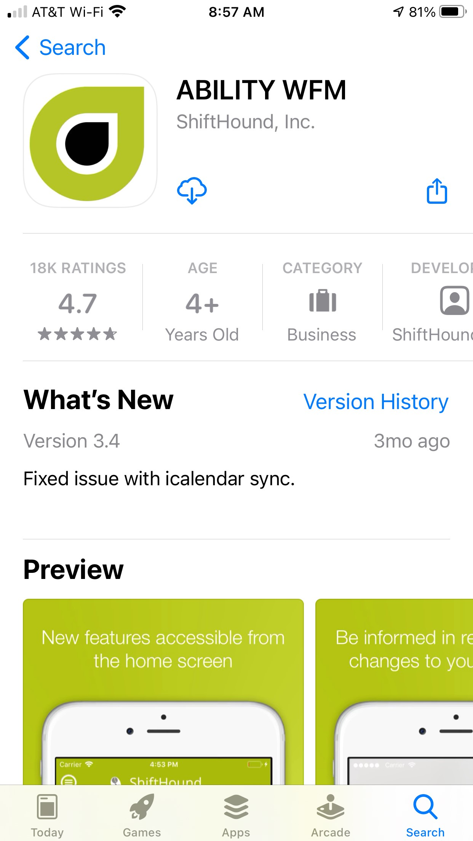
Why Inovalon SMARTFORCE?
SMARTFORCE continues to be the top-ranking mobile app in its class!
Rating 4.7 / 5 with > 17,000+ reviews
How we set ourselves apart of the rest:
100% healthcare
One stop shop for your workforce solutions
Excels at simplifying complexities
We understand the flexibility needed to meet unique needs
Importance on security and data protection
Training … in your configured environment (not a demo instance)
Professional, remote implementation team does the heavy lifting
Constantly innovating to meet your needs
We are committed to your success!

Slide 9
Staffing Insights
SMARTFORCE Dashboards

Slide 10
Financial Dashboards
The Staffing Insights module helps you manage budgets and productivity so you can protect your bottom line.
1
2
Control labor costs.
Avoid overtime.
3
4
Configurable tiles – choose only the ones you want to see.
See across the whole enterprise, drill down into a facility and dig deeper into specific departments.

Slide 11
Scheduling Health
Answer questions such as “How effectively are we scheduling our staff?”
1
2
Protect your staff.
Prevent burnout.
3
4
Ensure staff working up to commitments.
Spot trends which might be contributing to turnover.

Slide 12
Staff Health
Stop turnover before it happens with ABILITY. We can help you identify dissatisfied staff before it’s too late

